Slide 1

Applied Text Analytics ( F21AA ) Topic Modelling Heriot Watt University , Dubai Campus
Dr. Neamat El Gayar

Slide 2
Recap from last lecture
Supervised Learning models for text classification
k-Nearest Neighbors
Logistic regression
Support-vector machines
Notes:
Riochi

Slide 3
Todays of the lecture
N-Gram language model (short discussion)
Topic Modelling ( vs. clustering)
Examples
Models
Visualization of results
Python Implementations

Slide 4
Overview on Clustering
More details on week 5 overview slides + references

Slide 5
What is clustering?
Ch. 16
Clustering: the process of grouping a set of objects into classes of similar objects
Documents within a cluster should be similar.
Documents from different clusters should be dissimilar.
The most common form of unsupervised learning
Unsupervised learning = learning from raw data, as opposed to supervised data where a classification of examples is given
A common and important task that finds many applications in IR and other places

Slide 6
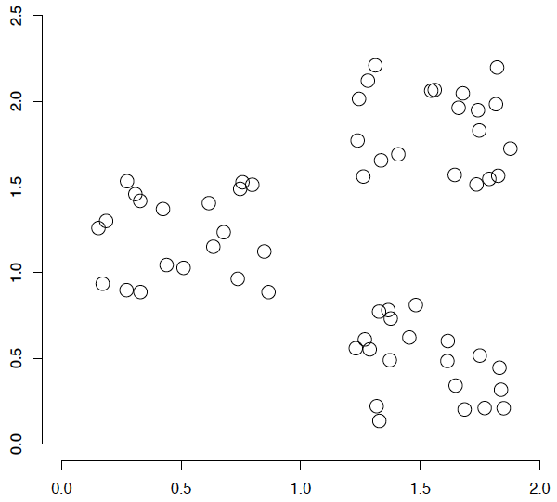
A data set with clear cluster structure
Ch. 16
How would you design an algorithm for finding the three clusters in this case?

Slide 7
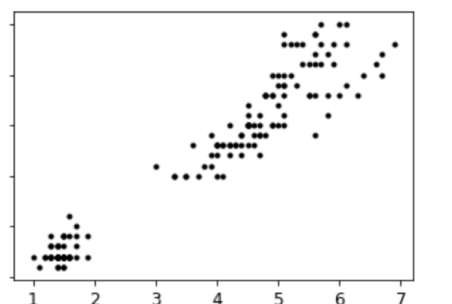
Another Example

Slide 8
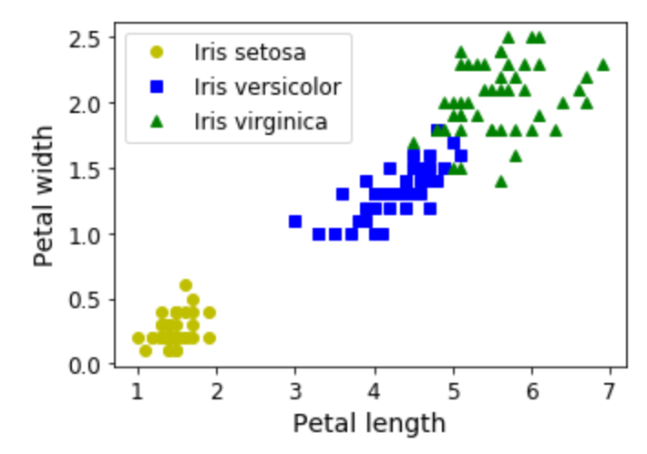
Another Example ( Iris Data)

Slide 9
Clustering text documents
Clustering algorithms aim to discover hidden structure in unlabelled data using features to organize instances into meaningfully dissimilar groups.
With text data, each instance is a single document or utterance, and the features are its tokens, vocabulary, structure, metadata, etc.
Unsupervised approaches can be incredibly useful for exploratory text analysis

Slide 10
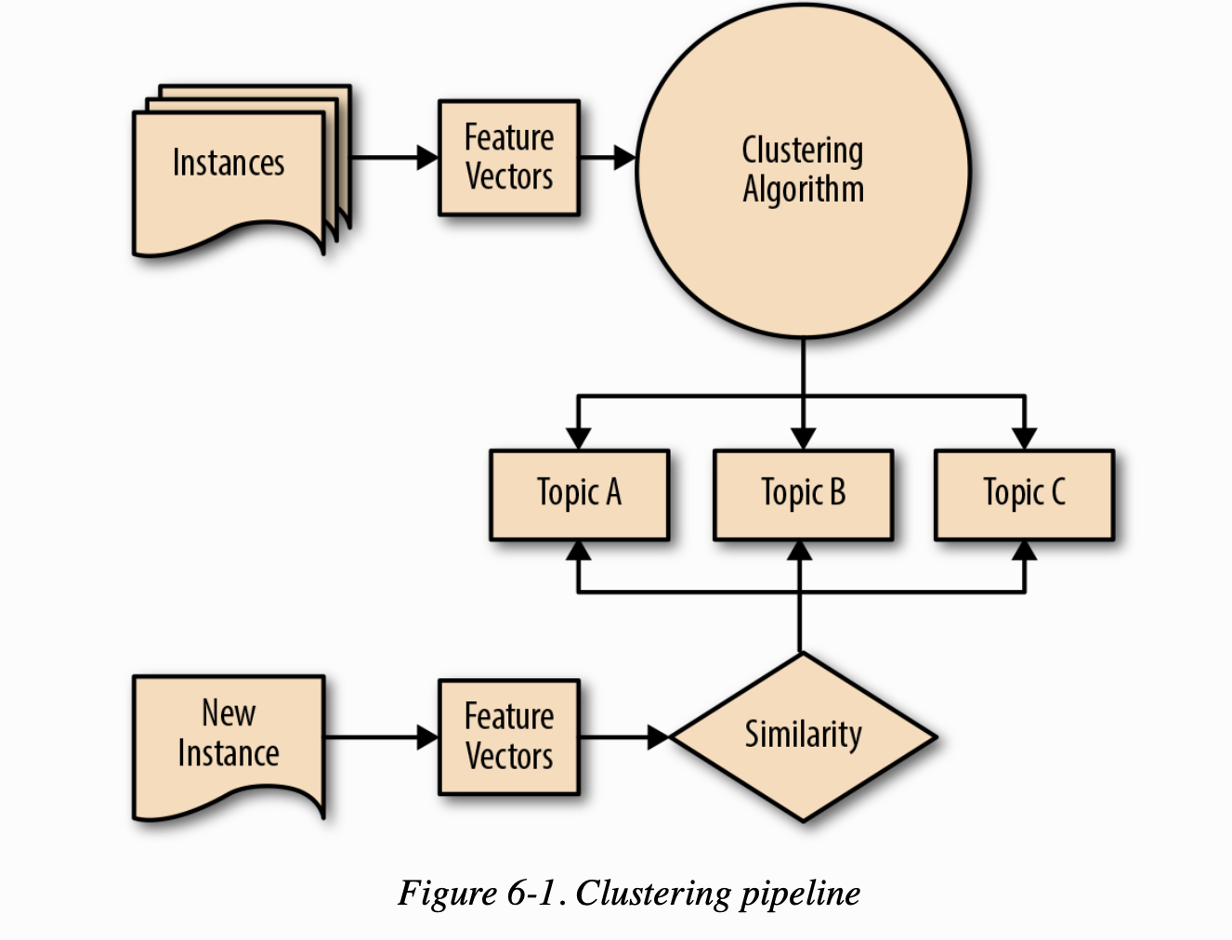
Clustering Pipeline
Notes:
“a corpus is transformed into feature vectors and a clustering algorithm is employed to create groups or topic clusters, using a distance metric such that documents that are closer together in feature space are more similar
“New incoming documents can then be vectorized and assigned to the nearest cluster”
Excerpt From: Benjamin Bengfort, Rebecca Bilbro, Tony Ojeda. “Applied Text Analysis with Python.” Apple Books.

Slide 11
Clustering Documents ( how it works)
Choose what it will mean for any two documents from our corpus to be similar or dissimilar.
Features of a document can inform similarity, from words and phrases to grammar and structure.
Similarity relies on our ability to imagine documents as points in space, where the relative closeness of any two documents is a measure of their similarity.

Slide 12
Issues for clustering
Sec. 16.2
Representation for clustering
Document representation
Vector space? Normalization?
Need a notion of similarity/distance
How many clusters?
Fixed a priori?
Completely data driven?
Avoid “trivial” clusters - too large or small

Slide 13
Notion of similarity/distance
Ideal: semantic similarity
Practical: term-statistical similarity
We will use cosine similarity.
Docs as vectors.
For many algorithms, easier to think in terms of a distance (rather than similarity) between docs.
We will mostly speak of Euclidean distance
But real implementations use cosine similarity

Slide 14
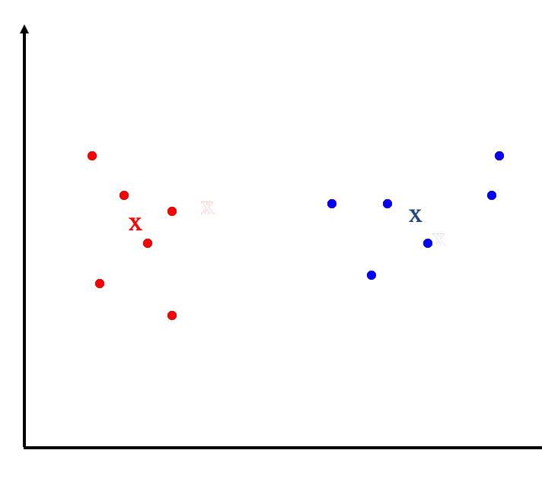
Clustering Algorithms
Flat algorithms
Usually start with a random (partial) partitioning
Refine it iteratively
Flat structure
Need to specify the number of classes in advance
K means clustering

Slide 15
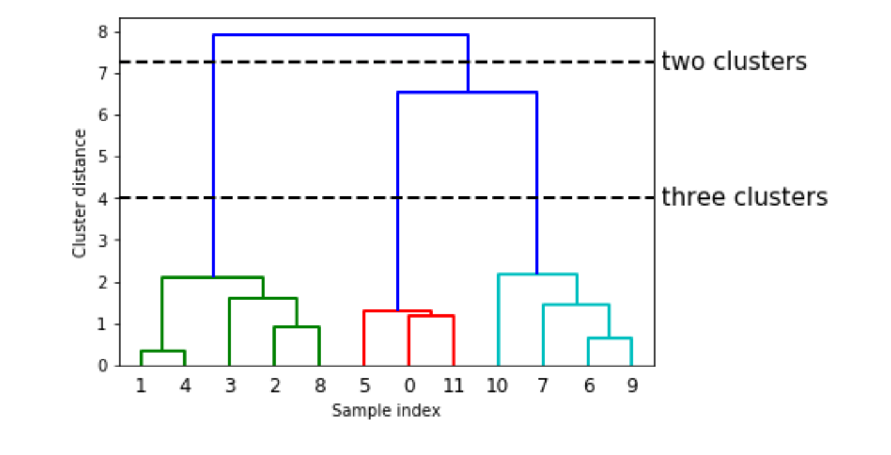
Clustering Algorithms
Hierarchical algorithms
Create a hierarchical decomposition of objects
Rich internal structure
No need to specify the number of clusters
Can be used to organize objects
Bottom-up, agglomerative
(Top-down, divisive)

Slide 16
Types of hierarchical clustering
Agglomerative (bottom up) clustering: It builds the dendrogram (tree) from the bottom level, and
merges the most similar (or nearest) pair of clusters
stops when all the data points are merged into a single cluster (i.e., the root cluster).
Divisive (top down) clustering: It starts with all data points in one cluster, the root.
Splits the root into a set of child clusters. Each child cluster is recursively divided further
stops when only singleton clusters of individual data points remain, i.e., each cluster with only a single point
Notes:
Agglomerative clustering is more popular than divisive methods.
At the beginning, each data point forms a cluster (also called a node).
Merge nodes/clusters that have the least distance, Go on merging, Eventually all nodes belong to one cluster
A few ways to measure distances of two clusters.
Results in different variations of the algorithm.
Single link
Complete link
Average link
Centroids

Slide 17
K-means
Sensitive to initial conditions (number of clusters, initial prototype choice, cluster shape and sample order )
Works well with compact, well separated clusters
Despite weaknesses, k-means is still the most popular algorithm due to its simplicity
NLTK’s implementation of k-means allows to define our own distance metric ( cosine similarity)
can be particularly slow with high-dimensional data such as text
Scikit-Learn offers a ‘Mini batch’ version to speed up convergence (but be careful as it uses Euclidean distance, which is less effective for text)
Notes:
Excerpt From: Benjamin Bengfort, Rebecca Bilbro, Tony Ojeda. “Applied Text Analysis with Python.” Apple Books.

Slide 18
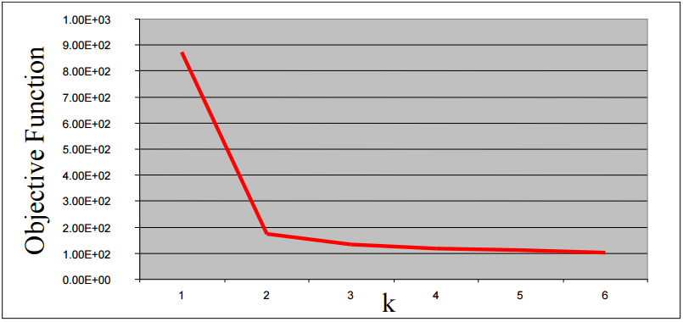
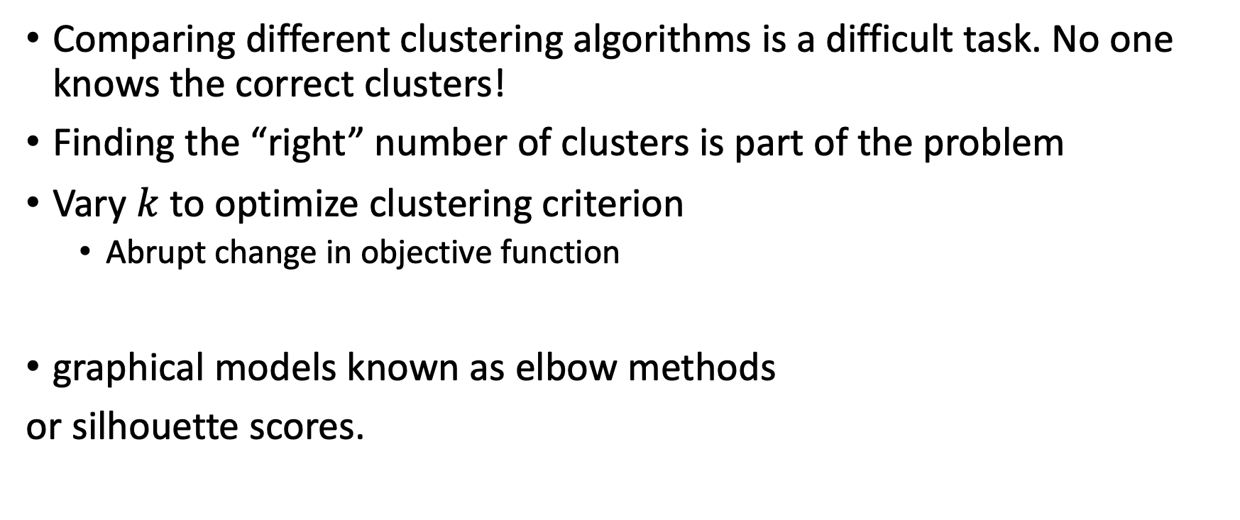
Experimenting with the value of K
Comparing different clustering algorithms is a difficult task. No one knows the correct clusters!
Finding the “right” number of clusters is part of the problem
Vary $k$ to optimize clustering criterion
Abrupt change in objective function
graphical models known as elbow methods
or silhouette scores.

Slide 19
Final Note on Clustering
Very powerful tool for initial data exploration and understanding (particularly if no labels are provided)
Flat clustering or agglomerative clustering do not provide much insight into why a document ended up in a particular cluster.
Next we will look at topic modelling , a way to group documents and also to effectively describe their contents

Slide 20
Topic Modelling

Slide 21
Topic Modelling
Topic modelling, an unsupervised machine learning technique for abstracting topics from collections of documents.
Topics can also be referred to : concepts, themes, genre ..
Clustering vrs Topic Modelling:
Clustering seeks to establish groups of documents within a corpus
Topic modelling aims to abstract core themes from a set of documents
Notes:
Topic Modelling

Slide 22
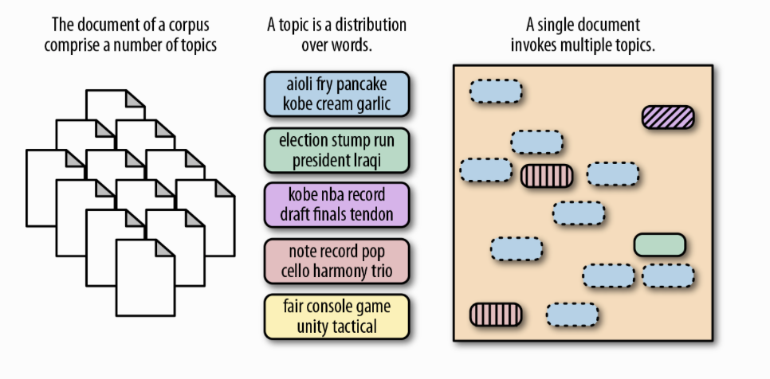
Topic modelling Example
Applied Text Analysis,

Slide 23
Topic Modelling ( How does it work)
Input: document-term matrix
Assumption :
Each topic is a distribution of words
Each document is a distribution of topics
Output: find the themes
Also find words within themes & find themes within documents
Example:
words :kale, banana , -→ theme : fruits
Words: Puppy, cute, frog -→ theme: animal
Notes:
A topic is formally defined as a distribution over a fixed vocabulary of words [29]. Different topics would have different distributions over the same vocabulary. A topic can be viewed as a cluster of words with related meanings, and each word has a corresponding weight inside this topic. Note that a word from the vocabulary can reside in multiple topics with different weights.
Every document is a probability distribution among topics
Every topic is a mix of words

Slide 24
Topic Modelling Techniques
You want to learn about the topic mix in each document and the word mix in each topic.
Often see the use of the word “latent” to describe many of these techniques, which refers to the fact that these concepts are hidden in the aggregate statistics of the data.
Topics are not labeled (i.e. not given in advance). Each topic is represented in terms of the words it has the highest probability of generating.
Notes:
often see the use of the word “latent” to describe many of these techniques, which refers to the fact that these concepts are hidden in the aggregate statistics of the data.
Latent= hidden or concealed.

Slide 25
Topic Modelling Example

Slide 26
Topic Modelling Techniques
Latent Dirichlet Allocation (LDA)
Find distribution of words in a topic P ( words\topics)
Find distribution of topics in a document P( topics\documents)
Use statistical inference to score new documents
Methods linked to dimensionality reduction & matrix factorization
Latent Semantic Analysis / Singular value Decomposition
Non-Negative Matrix Factorization

Slide 27
Latent Dirichlet Allocation (LDA)

Slide 28
Latent Dirichlet Allocation (LDA)
First introduced by David Blei, Andrew Ng, and Michael Jordan in 2003
[D. M. Blei, A. Y. Ng, and M. I. Jordan, “Latent Dirichlet Allocation,” Journal of Machine Learning Research, vol. 3, pp. 993–1022, 2003]
It belongs to the generative probabilistic model family:
Topics are represented as the probability that each of a given set of terms will occur.
Documents can in turn be represented in terms of a mixture of these topics.
LDA assumes that each latent topic follows a Dirichlet distribution over the vocabulary, and each document is represented as a random mixture of latent topics.
Notes:
The simplest topic model is latent Dirichlet allocation. In generative probabilistic modeling, data is treated as the result of a generative process that includes hidden variables. LDA assumes that there is a fixed vocabulary of words, and the number of the latent topics is predefined and remains constant. LDA assumes that each latent topic follows a Dirichlet distribution [30] over the vocabulary, and each document is represented as a random mixture of latent topics.

Slide 29
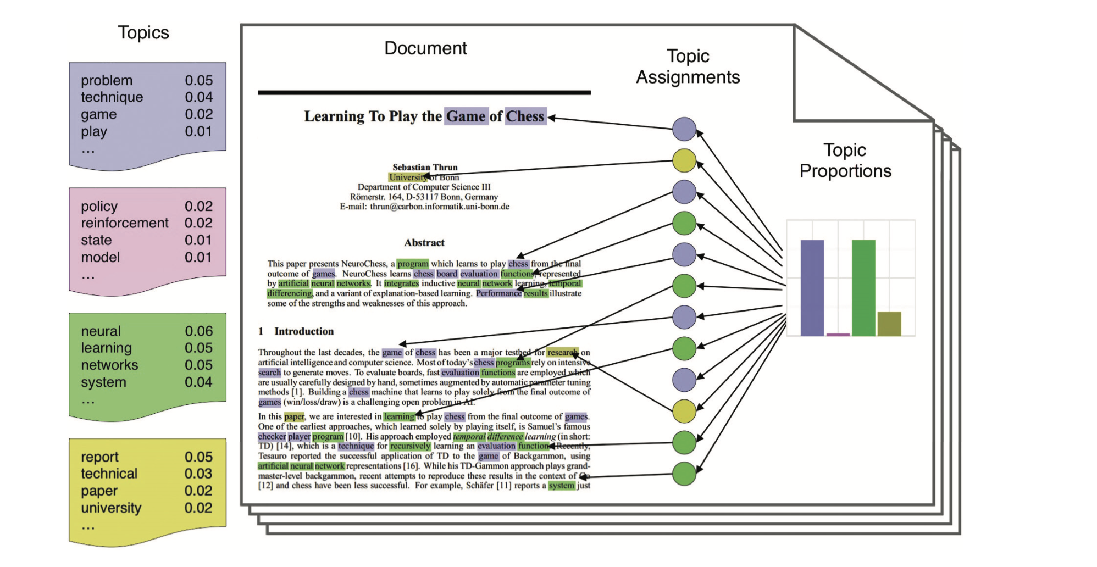
topics are related to problem, policy, neural, and report.
Data Science and Big Data Analytics, EMC Education Services, Wiley, 2015
Notes:
Figure 9-4 illustrates the intuitions behind LDA. The left side of the figure shows four topics built from a corpus, where each topic contains a list of the most important words from the vocabulary. The four example topics are related to problem, policy, neural, and report. For each document, a distribution over the topics is chosen, as shown in the histogram on the right. Next, a topic assignment is picked for each word in the document, and the word from the corresponding topic (colored discs) is chosen. In reality, only the docu-ments (as shown in the middle of the figure) are available. The goal of LDA is to infer the underlying topics, topic proportions, and topic assignments for every document.
The reader can refer to the original paper [Blei, A. Ng & Jordan]] for the mathematical detail of LDA. Basically, LDA can be viewed as a case of hierarchical Bayesian estimation with a posterior distribution to group data such as documents with similar topics.

Slide 30
LDA
LDA model tries to find groups of words (the topics) that appear together frequently.
A “topic” might not be what we would normally call a topic ( might or might not have a semantic meaning)
It can describe a genre ( writing style of a certain author)
Notes:
Intuitively, the LDA model tries to find groups of words (the topics) that appear together frequently. LDA also requires that each document can be understood as a “mixture” of a subset of the topics. It is important to understand that for the machine learning model a “topic” might not be what we would normally call a topic in every‐ day speech, but that it resembles more the components extracted by PCA or NMF (which we discussed in Chapter 3), which might or might not have a semantic mean‐ ing. Even if there is a semantic meaning for an LDA “topic”, it might not be some‐ thing we’d usually call a topic. Going back to the example of news articles, we might have a collection of articles about sports, politics, and finance, written by two specific authors. In a politics article, we might expect to see words like “governor,” “vote,” “party,” etc., while in a sports article we might expect words like “team,” “score,” and “season.” Words in each of these groups will likely appear together, while it’s less likely that, for example, “team” and “governor” will appear together. However, these are not the only groups of words we might expect to appear together. The two reporters might prefer different phrases or different choices of words. Maybe one of them likes to use the word “demarcate” and one likes the word “polarize.” Other “topics” would then be “words often used by reporter A” and “words often used by reporter B,” though these are not topics in the usual sense of the word.

Slide 31
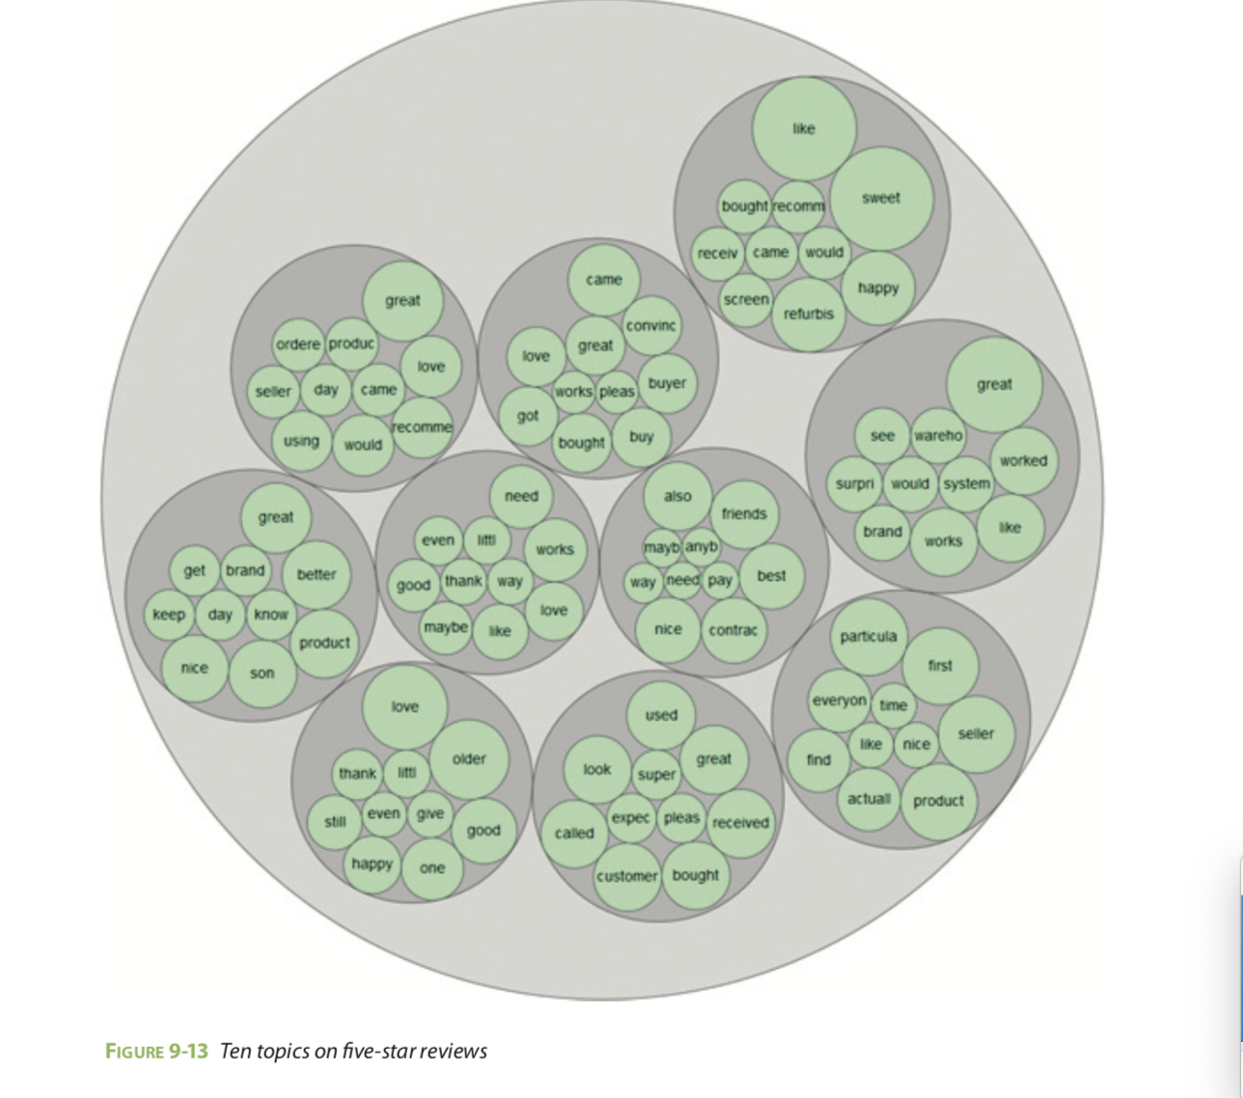
I-phone reviews
Notes:
Figure 9-13 visualizes ten topics built from the five-star reviews. Each topic focuses on a different aspect that can characterize the reviews. The disc size represents the weight of a word.

Slide 32
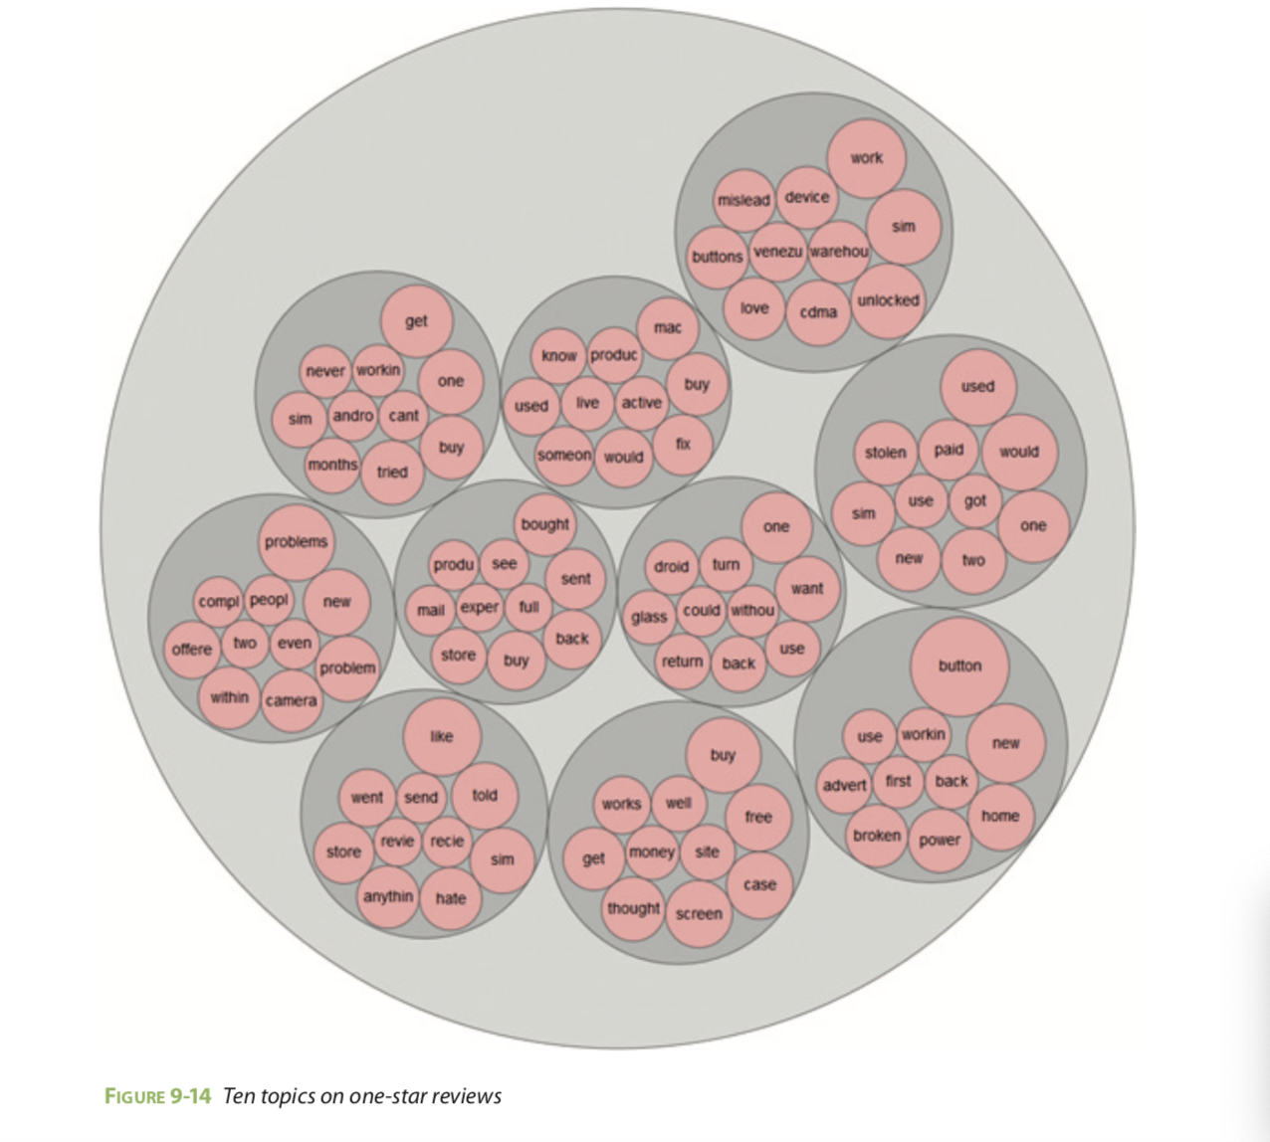
I-phone reviews
Notes:
Figure 9-14 visualizes ten topics from one-star reviews. For example, the bottom-right topic contains words such as button, power, and broken, which may indicate that bPhone has problems related to button and power supply. The Data Science team can track down these reviews and find out if that’s really the case.

Slide 33
LDA Movie data set
It is often good to remove very common words, as they might otherwise dominate the analysis.
We remove words that appear in at least 20 percent of the documents, and we’ll limit the bag-of-words model to the 10,000 words that are most common after removing the top 20 percent

Slide 34
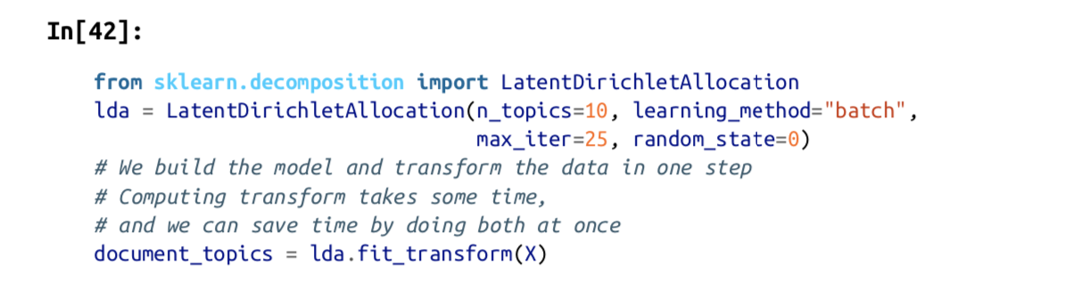
LDA in python
Notes:
We will learn a topic model with 10 topics, which is few enough that we can look at all of them. Similarly to the components in NMF, topics don’t have an inherent ordering, and changing the number of topics will change all of the topics.10 We’ll use the "batch" learning method, which is somewhat slower than the default ("online") but usually provides better results, and increase "max_iter", which can also lead to better models:

Slide 35
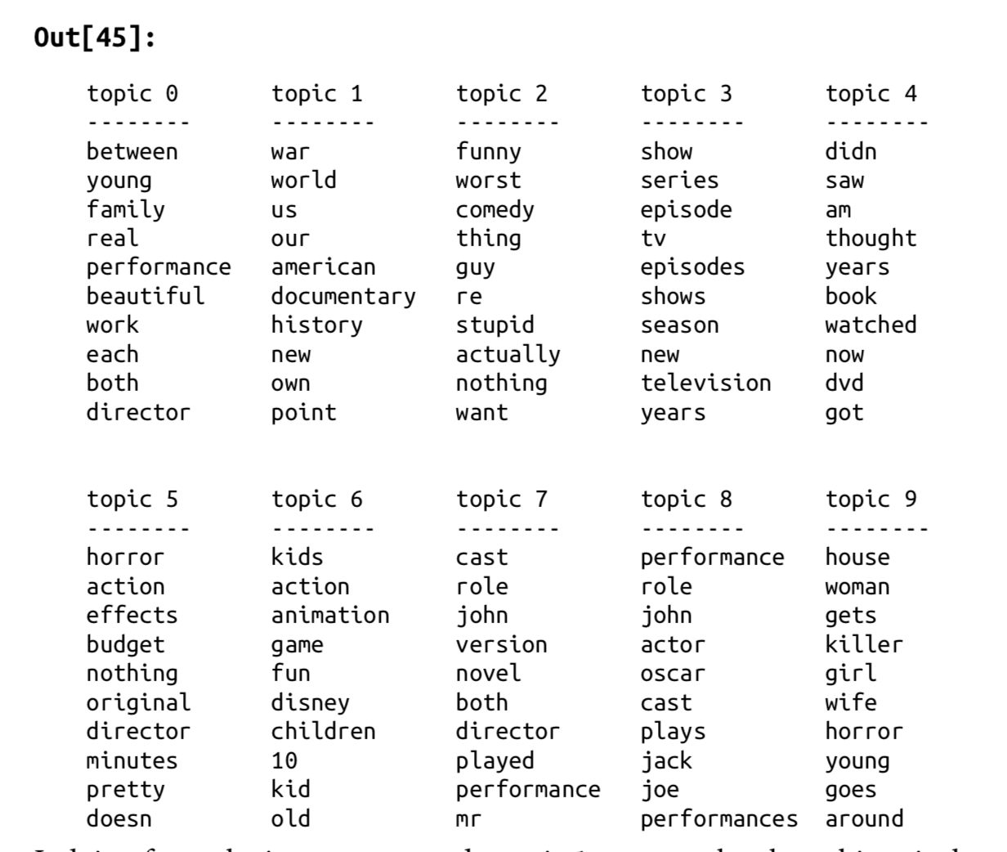
10 Movie topics
Notes:
looking at the highest- ranking words for each topic . Judging from the important words, topic 1 seems to be about historical and war mov‐ies, topic 2 might be about bad comedies, topic 3 might be about TV series. Topic 4 seems to capture some very common words, while topic 6 appears to be about child‐ ren’s movies and topic 8 seems to capture award-related reviews. Using only 10 topics, each of the topics needs to be very broad, so that they can together cover all the different kinds of reviews in our dataset.

Slide 36
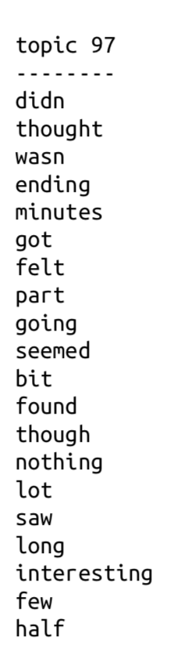
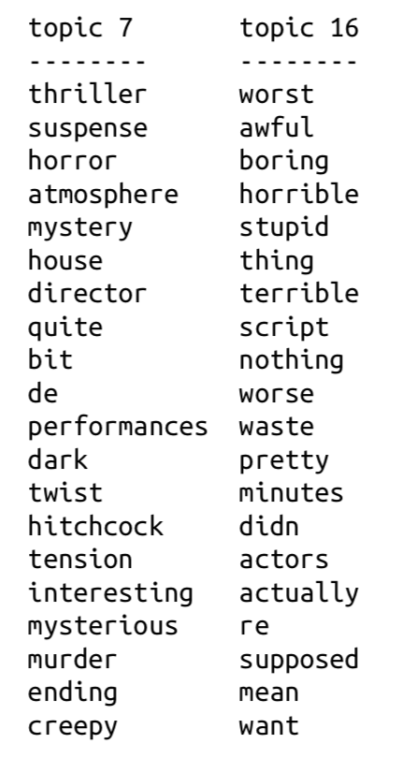
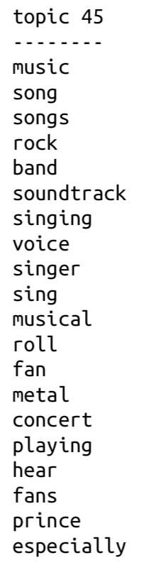
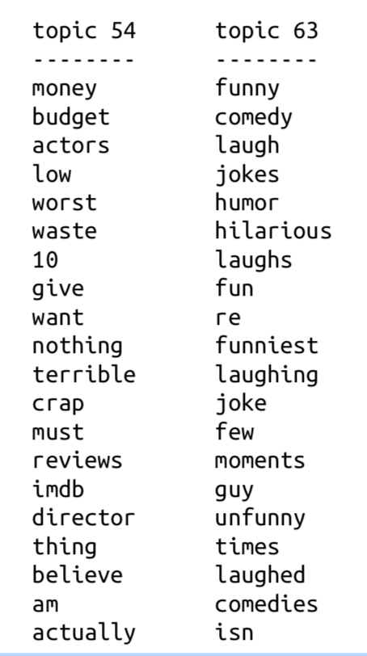
100 Movie topics
Notes:
The topics we extracted this time seem to be more specific, though many are hard to interpret. Topic 7 seems to be about horror movies and thrillers; topics 16 and 54 seem to capture bad reviews, while topic 63 mostly seems to be capturing positive reviews of comedies.
https://github.com/amueller/introduction_to_ml_with_python/blob/master/07-working-with-text-data.ipynb

Slide 37
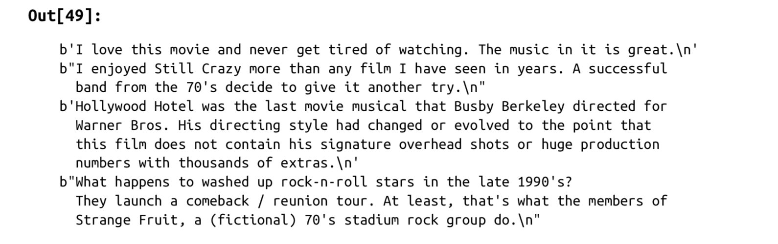
Example of movie reviews with topic 45
Genre specific Topics
Notes:
As we can see, this topic covers a wide variety of music-centered reviews, from musi‐ cals, to biographical movies, to some hard-to-specify genre in the last review.

Slide 38
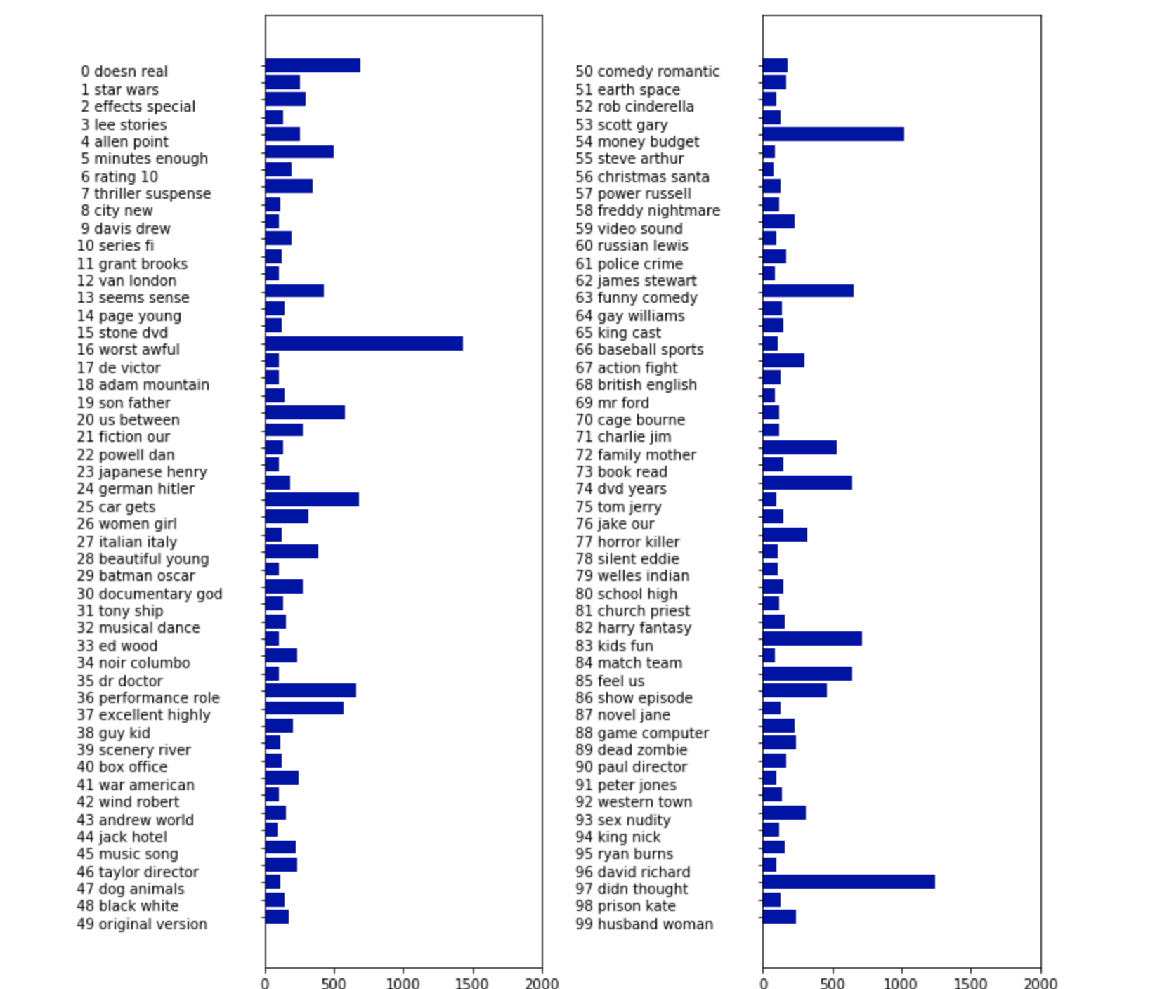
Weights for learned topics
Notes:
Graph shows how much weight each topic gets over‐ all, by summing the document_topics over all reviews. We name each topic by the two most common words.
The most important topics are 97, which seems to consist mostly of stopwords, possi‐ bly with a slight negative direction; topic 16, which is clearly about bad reviews; fol‐ lowed by some genre-specific topics and 36 and 37, both of which seem to contain laudatory words.
It seems like LDA mostly discovered two kind of topics, genre-specific and rating- specific, in addition to several more unspecific topics. This is an interesting discovery, as most reviews are made up of some movie-specific comments and some comments that justify or emphasize the rating.

Slide 39
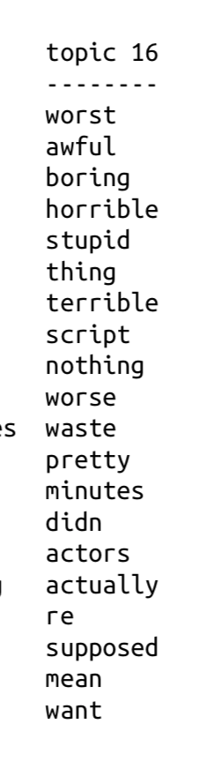
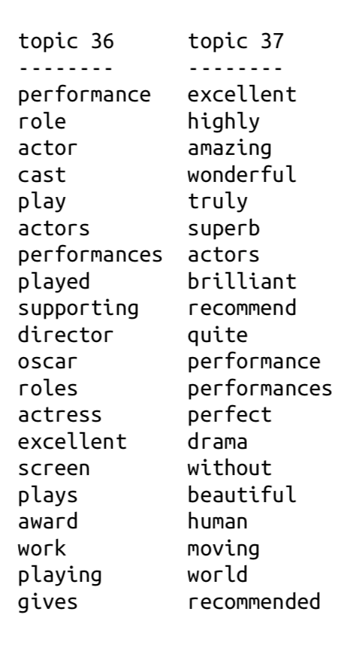
Rating specific topics

Slide 40
pyLDAvis interactive topic model visualisation
Check example 1 &2 : (Cornell movie reviews) https://ldavis.cpsievert.me/reviews/reviews.html

Slide 41
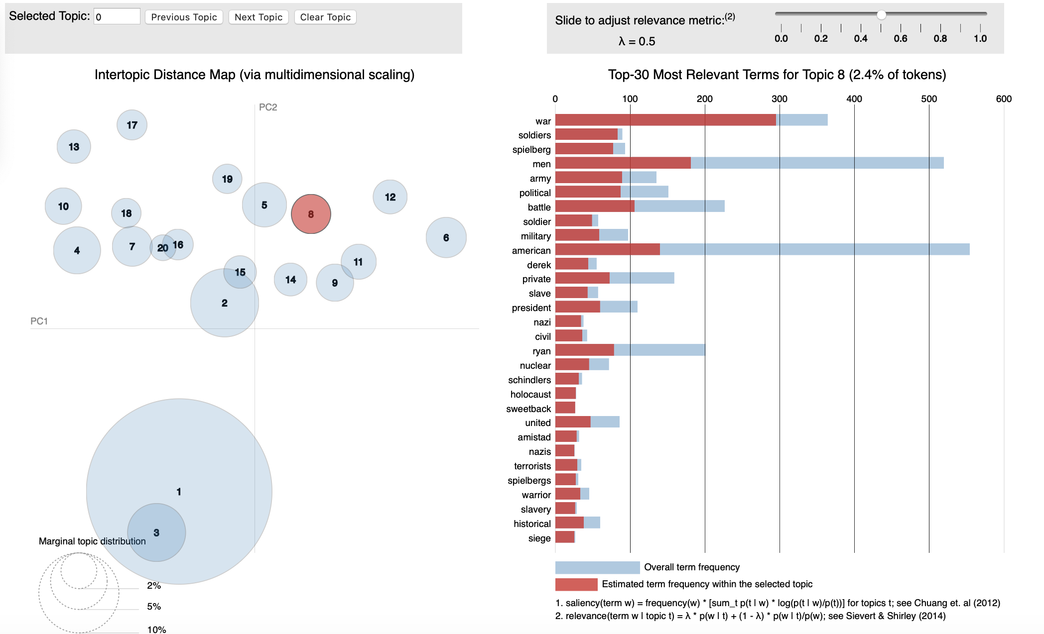
pyLDAvis interactive topic model visualisation
Notes:
Tuning parameter, 0≤λ≤1, controls how the terms are ranked for each topic, where terms are listed in decreasing of relevance, where the relevance of term w to topic t is defined as λ×p(w∣t)+(1−λ)×p(w∣t)/p(w)λ×p(w∣t)+(1−λ)×p(w∣t)/p(w). Values of λ near 1 give high relevance rankings to frequent terms within a given topic, whereas values of λ near zero give high relevance rankings to exclusive terms within a topic.
Exampe 1: in the movie review data, you can quickly see that Topic 7 is broadly about comedies
Topic 11
https://ldavis.cpsievert.me/reviews/vis/#topic=7&lambda=0.6&term=
For example, when you look at the 30 most relevant terms for Topic 5 using a relevance setting of [Math Processing Error]λ=0.5, the term “action” is the 6th bar from the top (i.e. the 6th most relevant term for this topic). The widths of the red and blue bars indicate that there is at least one other topic in which the term “action” appears frequently. By hovering over “action”, we see from the following state of LDAvis that term “action” also appears frequently in Topic 14 (as the 9th most relevant term):
http://cpsievert.github.io/LDAvis/reviews/vis/#topic=14&lambda=0.5&term=action
Comparing these two topics, we can see that Topic 5 discusses action in the context of movies about crime and police, whereas in Topic 14, the term “action”“ is also used frequently, but the topic is specifically about kung fu movies with Chinese actors (Jackie Chan and Jet Li, for example). These two topics both make heavy use of the word "action” but in slightly different contexts (i.e. slightly different styles of movies).

Slide 42
Latent Sematic Analysis LSA
Notes:
“Singular value decomposition (also known as latent semantic indexing in its text-centric implementations) is used for dimensionality reduction of sparse and extremely high-dimensional text into a more traditional multidimensional format of a few hundred dimensions. A side effect of the reduction is to reduce the noise effects of synonymy and polysemy. As in the case of document-term matrix, one can use the cosine similarity to compute similarity with the reduced representations of the documents. If the rank k is chosen carefully, it is possible to improve both precision and recall, although the former often degrades if the value of k is chosen incorrectly. The improvement in both precision and recall occurs because of the reduction in noise effects of synonymy and polysemy. Typically, for collections containing a few hundred thousand terms, it is often sufficient to use values of k between 200 and 400. Therefore, the reduction in dimensionality is very significant, but the new representation is no longer sparse.”
Excerpt From
Machine Learning for Text
Charu C. Aggarwal
This material may be protected by copyright.

Slide 43
LSA/SVD
Notes:
“Singular value decomposition (also known as latent semantic indexing in its text-centric implementations) is used for dimensionality reduction of sparse and extremely high-dimensional text into a more traditional multidimensional format of a few hundred dimensions.”
“Singular value decomposition (SVD) is used in all forms of multidimensional data, and its instantiation in the text domain is referred to as latent semantic analysis (LSA). Consider the simplest possible factorization of the n × d matrix D into an n × k matrix U = [u ij ] and the d × k matrix V = [v ij ] as an unconstrained matrix factorization problem:”- this graph the matricises are I in another order
Excerpt From Machine Learning for Text Charu C. Aggarwal This
“Using the derived diagonal topic importance matrix, we can identify the topics that are the most significant in our corpus, and remove rows that correspond to less important topic terms. Of the remaining rows (terms) and columns (documents), we can assign topics based on their highest corresponding topic importance weights.
Excerpt From: Benjamin Bengfort, Rebecca Bilbro, Tony Ojeda. “Applied Text Analysis with Python.” Apple Books.
For example, if we impose orthogonality constraints on the columns of U and V, this leads to a model known as singular value decomposition (SVD) or latent semantic analysis (LSA).

Slide 44
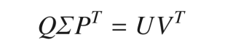
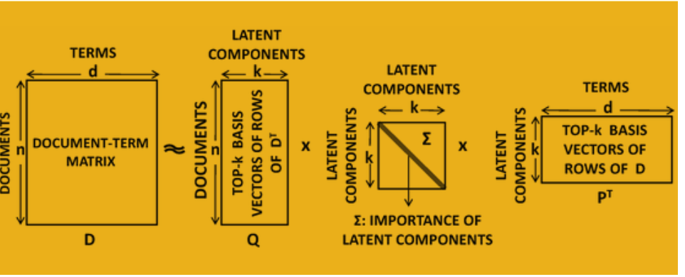
LSA/SVD (Terminology used)
Two-way matrix factorization D ≈ UV ^{T} into n × k and d × k matrices U and V, respectively,
Three-way matrix factorization
* k= number of topics , n=no of documents in corpus , d= no of terms (dictionary/vocabulary)
Notes:
“Singular value decomposition (also known as latent semantic indexing in its text-centric implementations) is used for dimensionality reduction of sparse and extremely high-dimensional text into a more traditional multidimensional format of a few hundred dimensions.”
“Singular value decomposition (SVD) is used in all forms of multidimensional data, and its instantiation in the text domain is referred to as latent semantic analysis (LSA). Consider the simplest possible factorization of the n × d matrix D into an n × k matrix U = [u ij ] and the d × k matrix V = [v ij ] as an unconstrained matrix factorization problem:”- this graph the matricises are I in another order
” k= number of topics , n=no of documents in corpus , d= no of terms (dictionary/vocabulary)
Excerpt From Machine Learning for Text Charu C. Aggarwal This
“Using the derived diagonal topic importance matrix, we can identify the topics that are the most significant in our corpus, and remove rows that correspond to less important topic terms. Of the remaining rows (terms) and columns (documents), we can assign topics based on their highest corresponding topic importance weights.
Excerpt From: Benjamin Bengfort, Rebecca Bilbro, Tony Ojeda. “Applied Text Analysis with Python.” Apple Books.
For example, if we impose orthogonality constraints on the columns of U and V, this leads to a model known as singular value decomposition (SVD) or latent semantic analysis (LSA).

Slide 45
LSA for topic modelling
Starts by a sparse term-document matrix, where each row is a token and each column is a document. (or vice versa)
Each value in the matrix corresponds to the frequency with which the given term appears in that document, and can be normalized using TF–IDF.
Singular Value Decomposition (SVD) is used to factorize the term-document matrix into matrices that represent the term-topics, the topic importance, and the topic-documents.
Notes:
also known as Latent Semantic Indexing

Slide 46
Cat/Car Example (Machine Learning for Text Charu C. Aggarwal, 2018 )
Reduced Representation ?
Notes:
“Therefore, consider a case where most documents contain a majority of their words from either the set { lion, lioness, cheetah, jaguar } or they contain a majority of the words from the set { jaguar, porsche, ferrari, maserati}. Intuitively speaking, these two sets define new features in terms of which the entire collection is expressed. In other words, a document containing most words from the first set can be expressed as (a, 0), a document containing most words from the second set can be approximately expressed as (0, b), and a document containing many words from both sets can be expressed as (c, d). One can view this new set of coordinates as a reduced representation of the data. Although it might seem that dimensionality reduction loses information, it is often possible to choose a representation dimensionality in which most of the semantic knowledge in the corpus is retained, and only noise is lost.”
“many retrieval and mining algorithms show improved accuracy when the reduced representation is used in lieu of the original representation. When a feature transformation improves the accuracy of an algorithm, it can be viewed as a feature engineering method.”
“new representation in the aforementioned example of cats and cars is able to pull out the hidden semantic concepts in the data, and express any document in the collection as a combination of these hidden (or latent) concepts”
often see the use of the word “latent” to describe many of these techniques, which refers to the fact that these concepts are hidden in the aggregate statistics of the data.”
Excerpt From
Machine Learning for Text
Charu C. Aggarwal
This material may be protected by copyright..

Slide 47

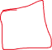
Cat/Car Example (Machine Learning for Text Charu C. Aggarwal, 2018 )
How do the notions of dimensionality reduction and latent semantic analysis relate to matrix factorization?
Notes:
“The first three documents are primarily related to cats, the fourth is related to both, and the last two are primarily related to cars. The word “jaguar” is polysemous because it could correspond to either a car or a cat and is present in documents of both topics.”
The dominant latent vector in P is [−0. 41, −0. 49, −0. 44, −0. 61, −0. 10, −0. 12], in which all components are negative. The second latent vector contains both positive and negative components. Therefore, the correspondence between the topics and the latent vectors is not very clear.”
“vectors have both positive and negative components, which reduces their interpretability. The lack of interpretability of singular value decomposition is its primary weakness, as a result of which other nonnegative forms of factorization are sometimes preferred. Furthermore, forcing orthogonality of the vectors in P is not very natural, especially when the two topics have overlapping and confounding words like “jaguar.”
Excerpt From: Charu C. Aggarwal. “Machine Learning for Text.” Apple Books.

Slide 48
Latent Sematic Analysis LSA
Latent Semantic Analysis (LSA) is a vector-based approach first suggested as a topic modelling technique by Deerwester et al in 1990
Also called Singular Value Decomposition (SVD)
n documents can be expressed as the rows of an n × k matrix U = [u ij ],
* k= number of topics , n=no of documents in corpus , d= no of terms (dictionary/vocabulary)
Notes:
“the k-dimensional reduced representations of the n documents can be expressed as the rows of an n × k matrix U = [u ij ], which is also the reduced representation of the corpus. The rows in U” “provide the document coordinates (i.e., transformed representation) with respect to the basis system in V.” “one can also view this problem as that of approximate factorization of the n × d document-term matrix D into two low-rank matrices of size n × k and d × k, respectively. ” k= number of topics , n=no of documents in corpus , d= no of terms (dictionary/vocabulary)
“It is noteworthy that only the solution satisfying the orthogonality constraint”
“The representation provided by SVD is not very interpretable and it is hard to match with the semantic concepts in the collection.” “better semantic interpretability can be obtained by imposing nonnegativity constraints on U and V.”
“topics of a text collection are often highly overlapping in terms of their vocabulary. As a result, the directions represented by the various topics are naturally not orthogonal, which matches poorly with orthogonal basis vectors. SVD does a poor job at revealing the actual semantic topics (or clusters) in the underlying data.”
“optimization problem for dimensionality reduction can be posed in terms of a two-way factorization, whereas in others we will pose it as a three-way factorization. This is because different choices are provide better interpretability in different settings, although they are mathematically equivalent.”
Excerpt From: Charu C. Aggarwal. “Machine Learning for Text.” Apple Books.
We say that 2 vectors are orthogonal if they are perpendicular to each other. i.e. the dot product of the two vectors is zero.
A set of vectors S is orthonormal if every vector in S has magnitude 1 and the set of vectors are mutually orthogonal.

Slide 49
Cat/Car Example (Machine Learning for Text Charu C. Aggarwal, 2018 )
reconstructed matrix is a very good approximation of the original document-term matrix
Notes:
“some forms of dimensionality reduction convert the two-way matrix factorization into a three-way matrix factorization in which each of the matrices satisfies certain normalization conventions. This additional matrix is typically a k × k diagonal matrix of nonnegative entries, in which the (r, r)th entry contains a scaling factor for the rth column. Specifically, for any two-way matrix factorization D ≈ UV T into n × k and d × k matrices U and V, respectively, we can convert it into a unique 2 three-way matrix factorization of the following form: Q (Sigma) (P)
Here, Q is a normalized n × k matrix (derived from U), P is a normalized d × k matrix (derived from V ), and Σ is a k × k diagonal matrix in which the diagonal entries contain the “nonnegative normalization factors for the k concepts.” “It is noteworthy that all diagonal entries of Σ are always nonnegative because of how the normalization is done.
“The entries in the diagonal matrix intuitively represent the relative dominance of the different latent concepts. For example, in our previous example with the car- and cat-related documents, if car documents are more copious than cat documents and also have higher term frequencies, this will be reflected in a higher diagonal value of Σ rr for the car-related entry. In a sense, Σ rr reflects the relative frequency of the rth latent concept in the collection.”
Excerpt From
Machine Learning for Text
Charu C. Aggarwal
This material may be protected by copyright.

Slide 50
SVD- a bit of math !
Source : Data Reduction Techniques ( Stanford lectures)

Slide 51
Sidenote: SVD ( data reduction technique)
n
n
m documents, n terms
Singular Valued Decomposition (SVD):
A: Input data matrix
U: Left singular vecs
V: Right singular vecs
Σ: Singular values
A
≈
Σ
V^{T}
m
m
U
Notes:
Svd is a data reduction teqniquev (lec 47 Stanford) https://www.youtube.com/watch?v=P5mlg91as1c&t=22s
Difference with SVD:
-- can multiply sigma with V and get the UV decomposition
-- SVD will count errors also on missing entries (zeros)
-- SVD insists U,V are orthonormal. We do not want this here, we do not care, we just want something that works
In linear algebra, the singular-value decomposition(SVD) is a factorization of a real or complex matrix. .. It has many useful applications in signal pro
cessing and statistics..
Formally, the singular-value decomposition of an m×n real or complex matrix M is a factorization of the form UΣV∗, where U is an m×m real or complex unitary matrix, Σ is an m×n rectangular diagonal matrix with non-negative real numbers on the diagonal, and V is an n×n real or complex unitary matrix. The diagonal entries σi of Σ are known as the singular values of M. The columns of Uand the columns of V are called the left-singular vectors and right-singular vectors of M, respectively.
The singular-value decomposition can be computed using the following observations:
The left-singular vectors of M are a set of orthonormal eigenvectors of MM∗.
The right-singular vectors of M are a set of orthonormal eigenvectors of M∗M.
The non-zero singular values of M (found on the diagonal entries of Σ) are the square roots of the non-zero eigenvalues of both M∗M and MM∗.
Applications that employ the SVD include computing the pseudoinverse, least squares fitting of data, multivariable control, matrix approximation, and determining the rank, range and null space of a matrix.

Slide 52
SVD - Definition
A_{[m x n]} = U_{[m x r]} Σ _{[ r x r]} (V_{[n x r]})^{T}
A: Input data matrix
m x n matrix (e.g., m documents, n terms)
U: Left singular vectors
m x r matrix (m documents, r concepts)
Σ: Singular values
r x r diagonal matrix (strength of each ‘concept’) (r : rank of the matrix A)
V: Right singular vectors
n x r matrix (n terms, r concepts)
Notes:
You want to discover ‘concepts’ which are hidden values (latent)-concept (genre-topics)
U is (document) to concept matrix
Diagnonal element (strength of every concept)
V term to concept
We learn something from the SVD
http://www.mmds.org/#book

Slide 53
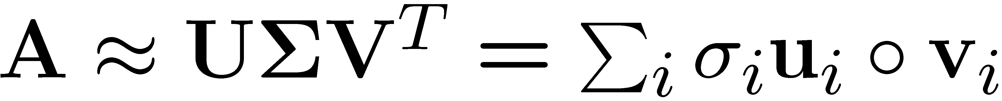
SVD
T
n
n
A
≈
Σ
V^{T}
m
m
U

Slide 54
SVD
T
n
σ₁u₁v₁
σ₂u₂v₂
A
≈
m
+
σ_{i} … scalar
u_{i} … vector
v_{i} … vector

Slide 55
SVD - Properties
It is always possible to decompose a real matrix A into A = U Σ V^{T} , where
U, Σ, V: unique
U, V: column orthonormal
U^{T} U = I; V^{T} V = I (I: identity matrix)
(Columns are orthogonal unit vectors)
Σ: diagonal
Entries (singular values) are positive, and sorted in decreasing order (σ₁ ≥ σ₂ ≥ ... ≥ 0)
Nice proof of uniqueness: http://www.mpi-inf.mpg.de/~bast/ir-seminar-ws04/lecture2.pdf
Notes:
Orthogonal = row U (dot product) column V =0
Orthonormal length column in U & V is 1 (Euclidean length 1)

Slide 56
End SVD- the math !
Source : Data Reduction Techniques ( Stanford lectures)

Slide 57
Cat/Car Example ( source: Charu C. Aggarwal. “Machine Learning for Text.)
-topics are naturally not orthogonal
-SVD cannot represent overlapping structures well +interpretability ?
Notes:
“he topics of a text collection are often highly overlapping in terms of their vocabulary. As a result, the directions represented by the various topics are naturally not orthogonal, which matches poorly with orthogonal basis vectors. SVD does a poor job at revealing the actual semantic topics (or clusters) in the underlying data. Most forms of nonnegative matrix factorization that do not use orthonogonal basis vectors can can represent overlapping structures
“The representation provided by SVD is not very interpretable a” “ it is hard to match with the semantic concepts in the collection. A key part of the problem is that the eigenvectors contain both positive and negative components that are hard to interpret.”
“The dominant latent vector in P is [−0. 41, −0. 49, −0. 44, −0. 61, −0. 10, −0. 12], in which all components are negative. The second latent vector contains both positive and negative components. Therefore, the correspondence between the topics and the latent vectors is not very clear.”
“vectors have both positive and negative components, which reduces their interpretability. The lack of interpretability of singular value decomposition is its primary weakness, as a result of which other nonnegative forms of factorization are sometimes preferred. Furthermore, forcing orthogonality of the vectors in P is not very natural, especially when the two topics have overlapping and confounding words like “jaguar.”
Excerpt From: Charu C. Aggarwal. “Machine Learning for Text.” Apple Books.

Slide 58
Non-Negative Matrix Factorization (NNMF)

Slide 59
Non negative matrix factorization (NNMF)
Notes:
“To apply NNMF for topic modeling, we begin by representing our corpus as we did with our Latent Semantic Analysis, as a TF–IDF normalized term-document matrix.”

Slide 60
Non negative matrix factorization (NNMF)
highly interpretable type of matrix factorization
Notes:
“Nonnegative matrix factorization is a highly interpretable type of matrix factorization in which nonnegativity constraints are imposed on U and V.”
“U = [u ij ] is an n × k matrix and V = [v ij ] is a d × k matrix of optimization parameters. Note that the optimization objective is the same but the constraints are different.”
Excerpt From Machine Learning for Text, Charu C. Aggarwal
This material may be protected by copyright.

Slide 61
Non negative matrix factorization (NNMF)
First introduced by Pentti Paatero and Unto Tapper (1994) and known in Nature article by Daniel Lee and H. Sebastian Seung (1999)
NNMF has many applications, including spectral data analysis, collaborative filtering for recommender systems, and topic extraction
Document-Term matrix is decomposed into two factors whose product approximates the original
Every value in both factors is either positive or zero. The resulting matrices illustrate topics positively related to terms and documents of the corpus
Notes:
“Nonnegative matrix factorization is a highly interpretable type of matrix factorization in which nonnegativity constraints are imposed on U and V.”
Excerpt From: Charu C. Aggarwal. “Machine Learning for Text.” Apple Books.

Slide 62
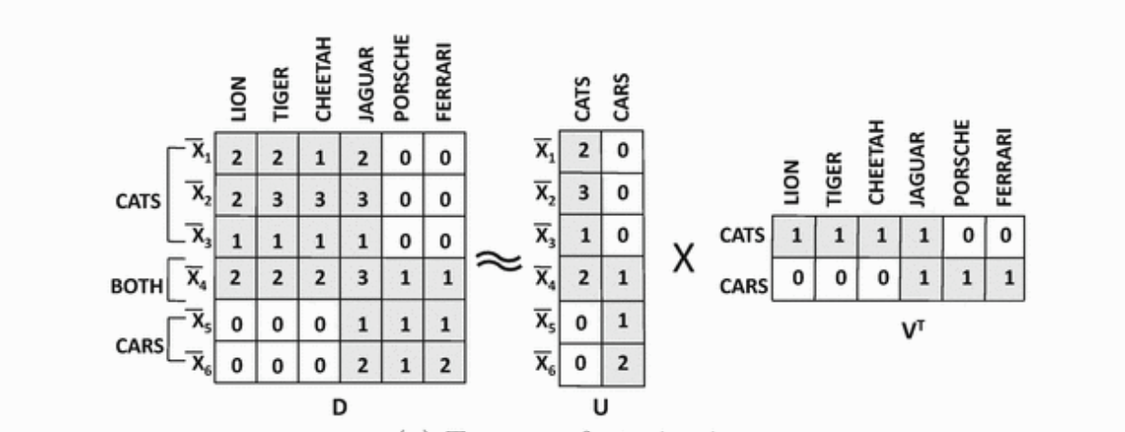
Cat/Car Example –two way factorization
Interpretability of nonnegative matrix factorization
Notes:
“It is clear that the first latent concept is related to cats and the second latent concept is related to cars. Furthermore, documents are represented by two non-negative coordinates indicating their affinity to the two topics. Correspondingly, the first three documents have strong positive coordinates for cats, the fourth has strong positive coordinates in both, and the last two belong only to cars. The matrix V tells us that the vocabularies of the various topics are as follows:
Cats: lion, tiger, cheetah, jaguar
Cars: jaguar, porsche, ferrari”
“the polysemous word “jaguar” is included in the vocabulary of both topics, ”
Excerpt From
Machine Learning for Text
Charu C. Aggarwal
This material may be protected by copyright.

Slide 63
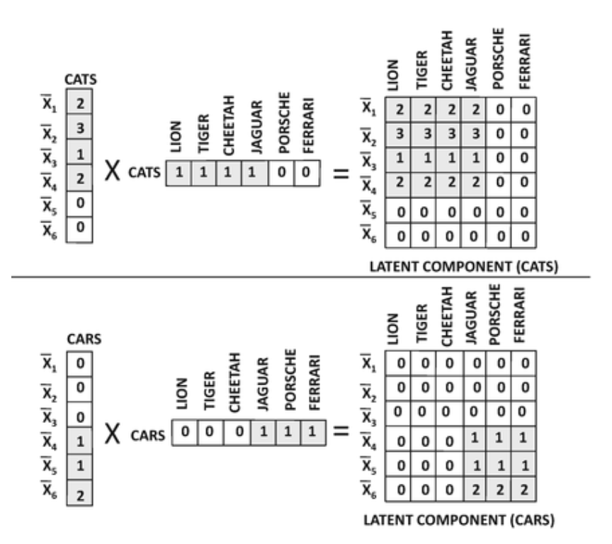
Cat/Car Example
Interpretability of nonnegative matrix factorization
Notes:
“decompose the original matrix into two rank-1 matrices according to Eq. 3.23. This decomposition is shown in Fig. 3.3 in which the rank-1 matrices for cats and cars are shown. It is particularly interesting that the occurrences of the polysemous word “jaguar” are nicely divided up into “the two topics, which roughly correspond with their usage in these topics.”
Excerpt From
Machine Learning for Text
Charu C. Aggarwal
This material may be protected by copyright.

Slide 64
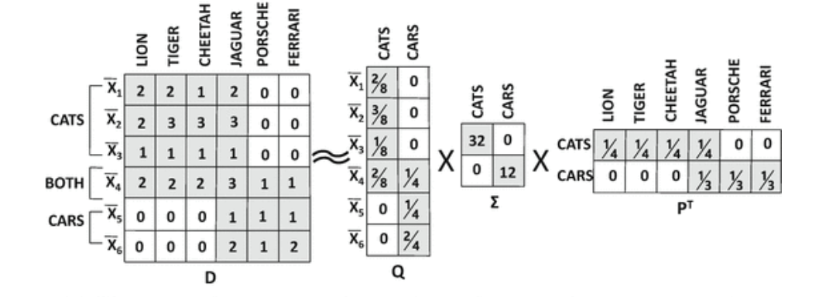
Cat/Car Example- three way matrix factorization
Interpretability of nonnegative matrix factorization
Notes:
“any two-way matrix factorization can be converted into a standardized three-way factorization. The three-way normalized representation is shown in Fig. 3.2b, and it tells us a little bit more about the relative frequencies of the two topics. Since the diagonal entry in Σ is 32 for cats in comparison with 12 for cars, it indicates that the topic of cats is more dominant than cars. This is consistent with the observation that more documents and terms in the collection are associated with cats as compared to cars.”
Excerpt From
Machine Learning for Text
Charu C. Aggarwal
This material may be protected by copyright.

Slide 65
LSA & NNMF in Scikit-Learn
from sklearn.decomposition import LatentDirichletAllocation
from sklearn.decomposition import NMF
'LSA': TruncatedSVD()
‘NMF': NMF()
‘LDA’: LatentDirichletAllocation()
Check also Gensim library
Benjamin Bengfort, Rebecca Bilbro, Tony Ojeda. “Applied Text Analysis with Python.”

Slide 66
LDA vs. LSA
Latent Dirichlet Allocation works by abstracting topics from documents.
Topics can be be used to score documents by their proportion of topical terms
Latent Semantic Analysis simply finds groups of documents with the same words

Slide 67
Summary
Which models works best?
the best model will depend a great deal on the corpus you are working with and the goals of your application.
LSA is sometimes considered better for learning descriptive topics, which is helpful with longer documents and more diffuse corpora.
Latent Dirichlet Allocation and non-negative matrix factorization, on the other hand, can be better for learning compact topics, which is useful for creating succinct labels from topics.
However, most topic models suffer from the problem of multiple local maxima
Make it hard to reproduce research results
Make it hard to interpret results in real applications
Notes:
Source: Benjamin Bengfort, Rebecca Bilbro, Tony Ojeda. “Applied Text Analysis with Python.

Slide 68
Take home
Today lab5 (Movie Review Example)
See Python notebook for detailed information on references & code. You will practice:
Topic Modelling
Topic Model Visualization using pyLDAvis

Slide 69
References
Benjamin Bengfort, Rebecca Bilbro, Tony Ojeda. “Applied Text Analysis with Python.
( Interesting pipelines) - check Part II Overview on Workflows & Pipelines
Chapter 7: An Introduction to Machine Learning with Python by Andreas C. Müller and Sarah Guido (O’Reilly). (Movie Review Example)
Charu C. Aggarwal. “Machine Learning for Text. (SVD/LDA-NNMF-Cat/Car example)

Slide 70
Some Links & practitioners codes
Practical tips (could be useful)
https://www.kdnuggets.com/2019/09/overview-topics-extraction-python-latent-dirichlet-allocation.html
Advanced
https://www.kdnuggets.com/2018/08/topic-modeling-lsa-plsa-lda-lda2vec.html
NLTK - Gensim
https://towardsdatascience.com/topic-modelling-in-python-with-nltk-and-gensim-4ef03213cd21
PyLDAvis (Visualization)
http://medium.com/@sherryqixuan/topic-modeling-and-pyldavis-visualization-86a543e21f58
https://towardsdatascience.com/topic-model-visualization-using-pyldavis-fecd7c18fbf6

Slide 71
Thank You

